Slide 1
Customer Review Analysis
BY
HARSH SHAH

Slide 2
CONTENTS
CRISP
Business Understanding
Data Understanding
Data Preparation
Modeling
Evaluation
Deployment
Attachments

Slide 3
CRISP DM

Slide 4
BUSINESS UNDERSTANDING
This phase is aimed at defining the business objectives of a manufacturer, suppliers and retailers
The proposed goal is to analyze customer reviews of products from two different manufacturers and determine the requirements of a customer using text mining model
Suppliers and retailers should assess the market to determine the product to deal in based on the analysis
The model should help the manufacturers to make changes in the existing products, while suppliers and retailers can determine which product to stock up

Slide 5
DATA UNDERSTANDING
Data collection
The data was collected from https://s3.amazonaws.com/amazon-reviews-pds/tsv/index.txt. Shoes category was selected for customer review analysis
The file contains more than 1000000 samples of and 15 variables
The variables include marketplace, customer_id, review_id, product_id, product_parent, product_title, product_category, star_rating, helpful_votes, total_votes, vine, verified_purchase, review_headline, review_body, review_date
The data is information about shoes of different companies sold by amazon
10000 samples of shoes from NIKE and SKECHERS each were extracted from the csv file to compare the sentiments of customers

Slide 6
DATA PREPARATION
The 10000 samples were cleaned using the CLEAN function in Excel to eliminate non-printable characters from the text as shown in image 1.1
From the 10000 samples, copied the customer review column and pasted it in the text editor to create Nike.txt and Skecher.txt file
Loaded .txt file on WORDij to create a .net file and eliminate stop words using stopword.txt file
The ‘Drop words appearing less often than’, ‘Drop pairs appearing less often than’, and ‘Window size for extracting word pairs’ parameters were set to 3, 3, and 2 as shown in image 1.2
Analyzed both Nike.txt and Skecher.txt to obtain the network shown in image 1.3 and image 1.4 respectively

Slide 7
MODELING
Used Gephi software to analyze both the text file
Analyzing Nike.txt and Skecher.txt in WORDij, generated Nike.net and Skecher.Net which were opened in Gephi to be analyzed
Initially there were 2311 nodes and 5867 edges in the Nike data, 2670 nodes and 8257 edges in the Skechers data
The Nodes and Edges for Nike were reduced to 35 nodes, 776 edges by setting the Degree Range filter to 62-547
The Nodes and Edges for Skecher were reduced to 33 nodes, 817 edges by setting the Degree Range filter to 83-764
Run the modularity at resolution 1.0 to create 3 communities for both Nike and Skechers

Slide 8
MODELING
Applied the Fruchterman Reingold layout to generate networks for Nike and Skechers shown in image 1.5 and image 1.6 respectively
The network for Nike shows a strong connection between ‘son’ and ‘love’ in cluster 1, ‘running’, ‘shoes’, and ‘great’ in cluster 0
The network for Skechers shows a strong connection between ‘daughter’ and ‘love’ in cluster 2, ‘shoes’, and ‘great’ in cluster 0, ‘day’ and ‘wear’ in cluster1
The above results explains that most of the Nike shoes were bought for boys and were running shoes, while most of the Skechers shoes were bought for girls and were daily wear shoes
The next step was to run Network Diameter, Page Rank and Avg. Clustering Coefficient to generate reports shown in image 1.7, image 1.8, image 1.9, image 2.0, image 2.1, image 2.2

Slide 9
MODELING
Analyzing the spreadsheet generated for both Nike and Skechers in Gephi by focusing on Modularity class to determine possible sentiments by customers as shown in image 2.3 and image 2.4 respectively
For Nike: in class 0, the possible sentiments could be perfect fitting, great looks, comfortable for running. In class 1, bought for son and he loves the shoes. In class 2, the shoes are a little narrow to fit in the feet.
For Skechers: in class 0, the possible sentiments could be great looks, comfortable wearing to work, good price. In class 1, perfect for daily wear, a little wide for feet. In class 2, daughter loves the shoes

Slide 10
EVALUATION
The results show that both Nike and Skechers are great in quality looks and price, as well as comfort
Nike is more likely bought for running purpose whereas Skechers can be bought for daily wear
For comparison of analysis we are going to use Knime to analyze data from both Nike and Skechers
The results are similar to the analysis made with Gephi as shown in image 2.5 for Nike and image 2.6 for Skechers

Slide 11
DEPLOYMENT
The analysis done can help suppliers and retailers to determine the products to deal in more. For example, the analysis shows that most Nike shoes were bought for boys which means the suppliers and retailers can stock up Nike shoes for boys. Another analysis shows that Nike shoes are narrow according to customer’s reviews, which means retailers can offer Nike shoes to customers looking for narrow fit
Similarly analysis on Skechers customer review shows that the targeted category of customers should be girls and people with wide fit

Slide 12
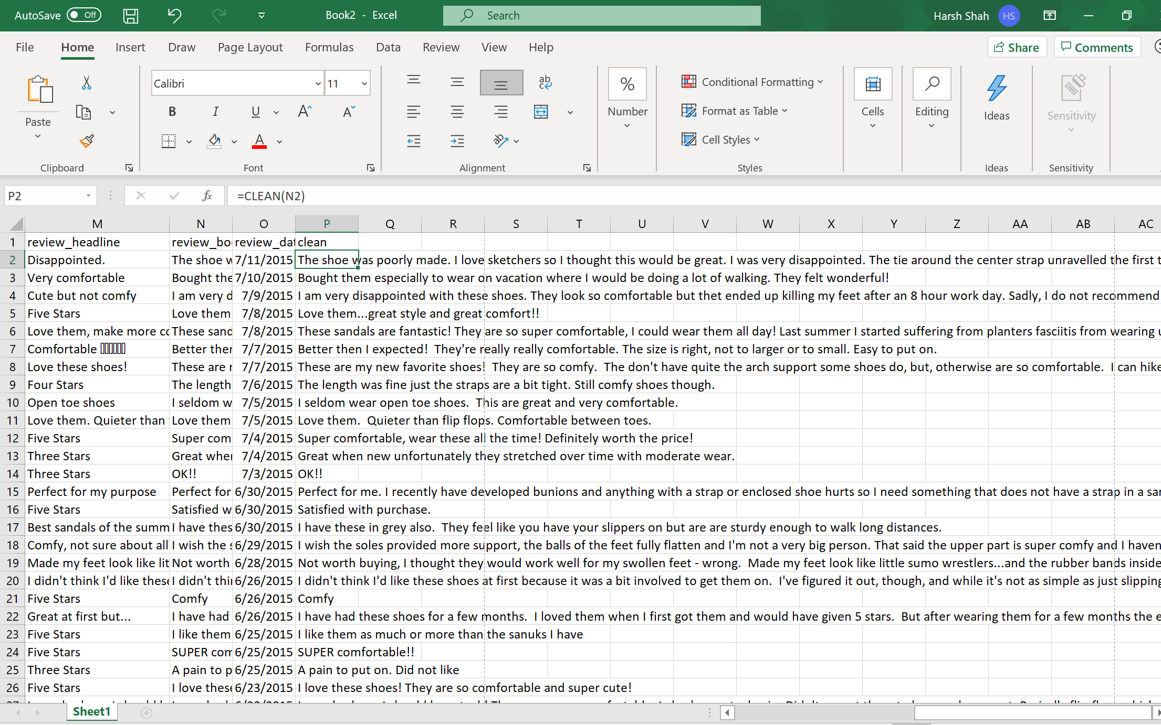
ATTACHMENT
Image 1.1

Slide 13
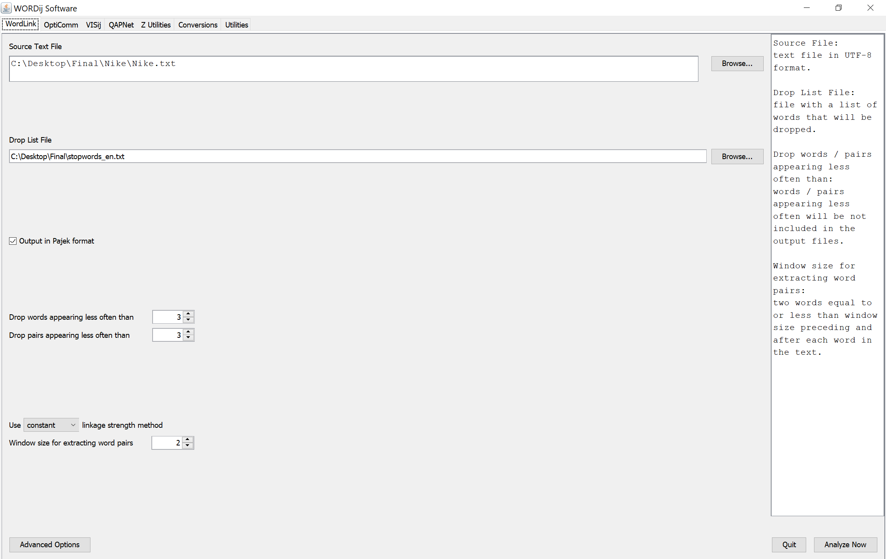
ATTACHMENT
Image 1.2

Slide 14
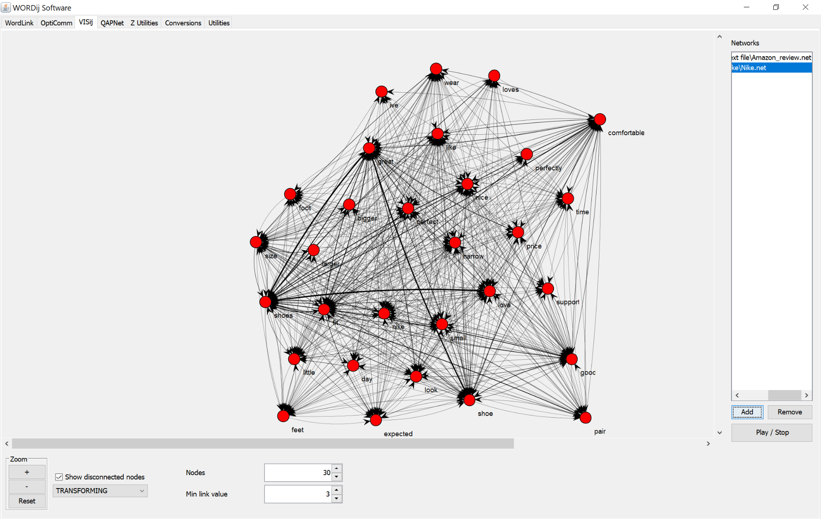
ATTACHMENT
Image 1.3

Slide 15
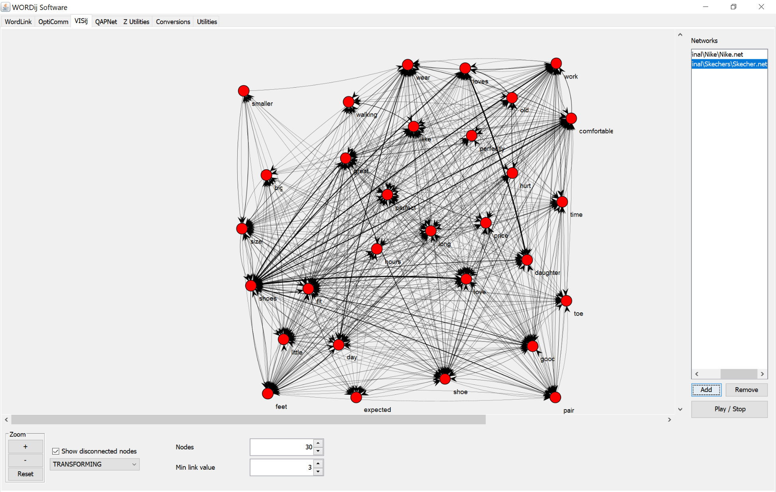
ATTACHMENT
Image 1.4

Slide 16
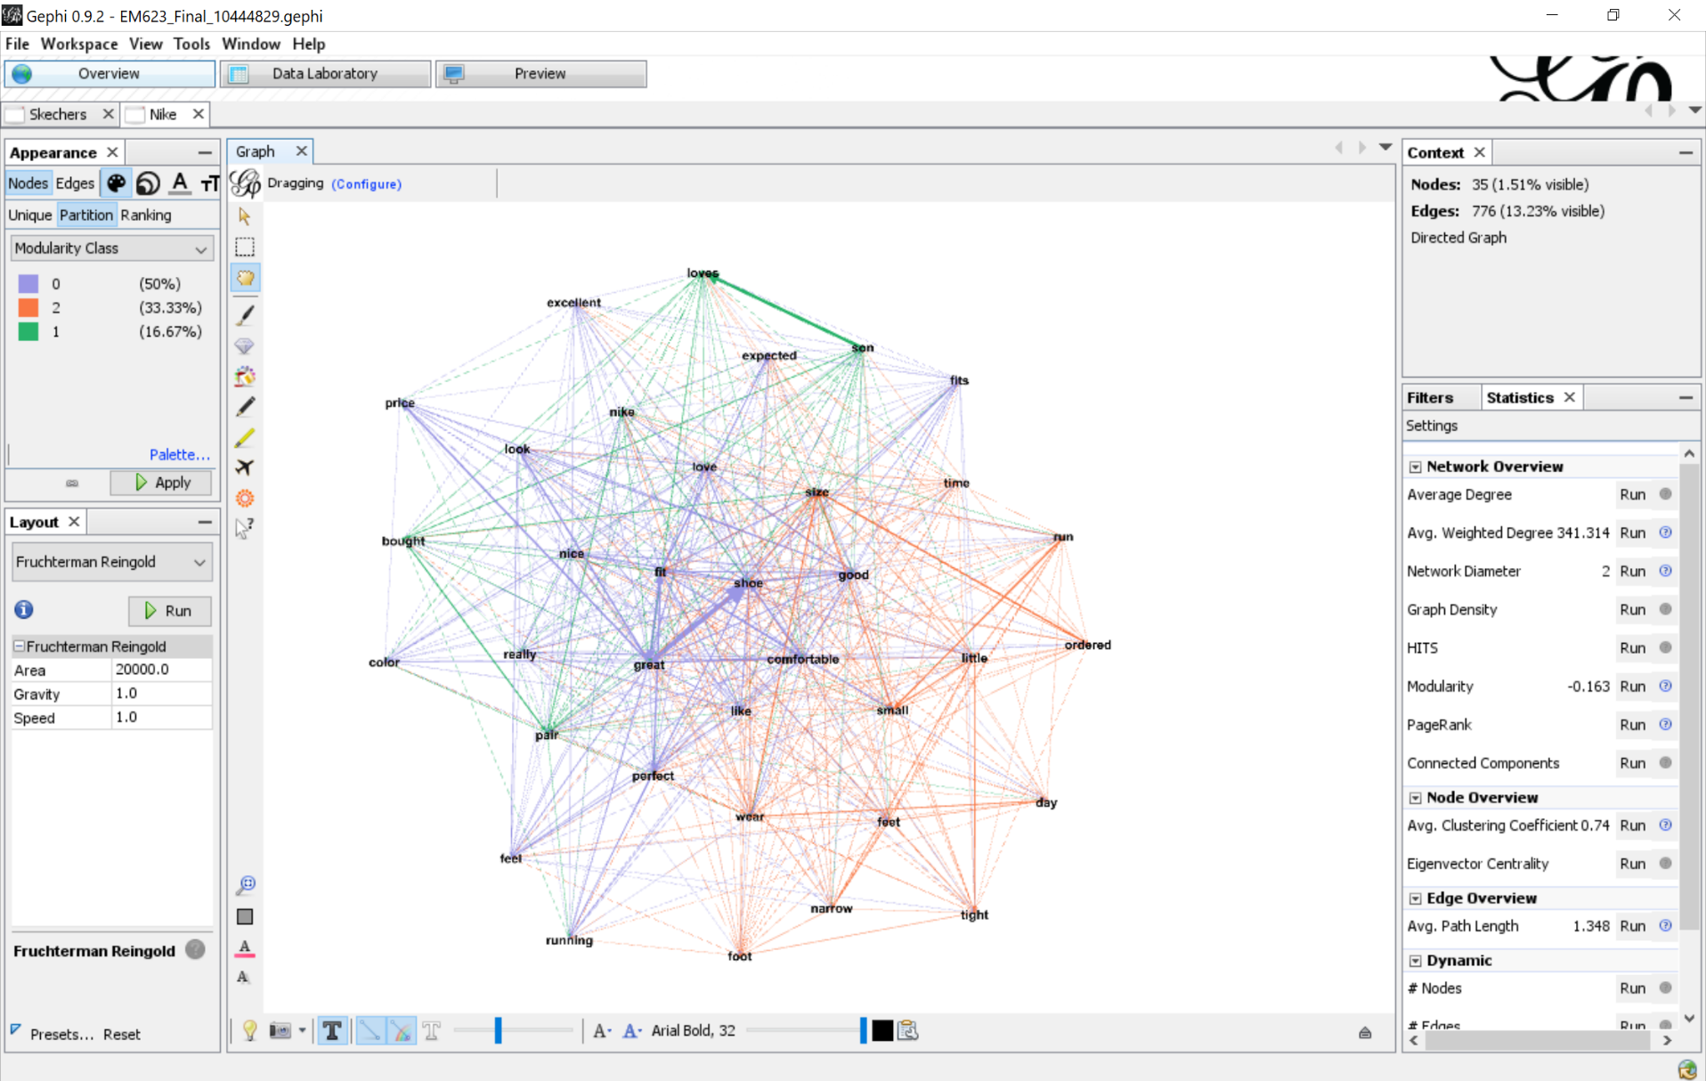
ATTACHMENT
Image 1.5

Slide 17
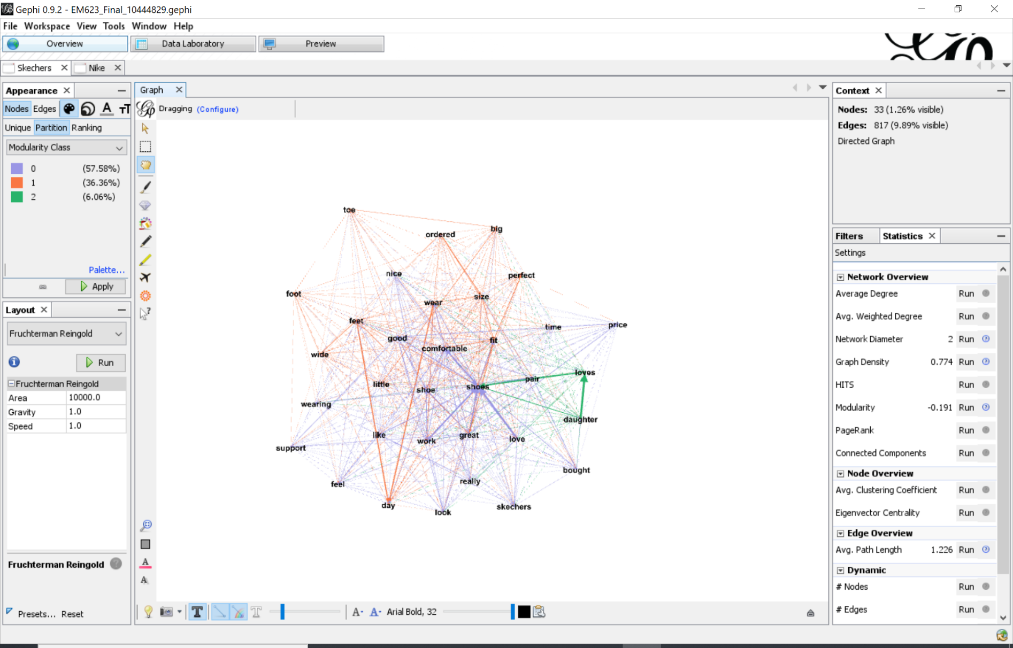
ATTACHMENT
Image 1.6

Slide 18
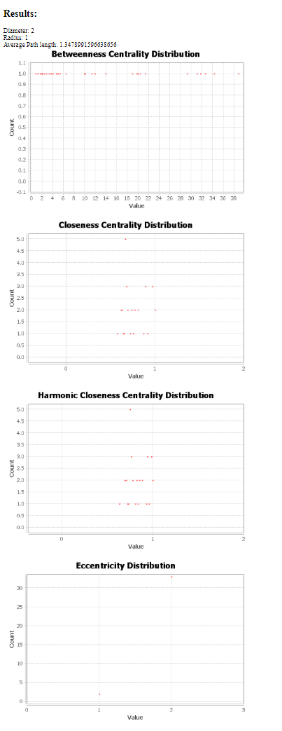
ATTACHMENT
Image 1.7
Nike Network Diameter

Slide 19
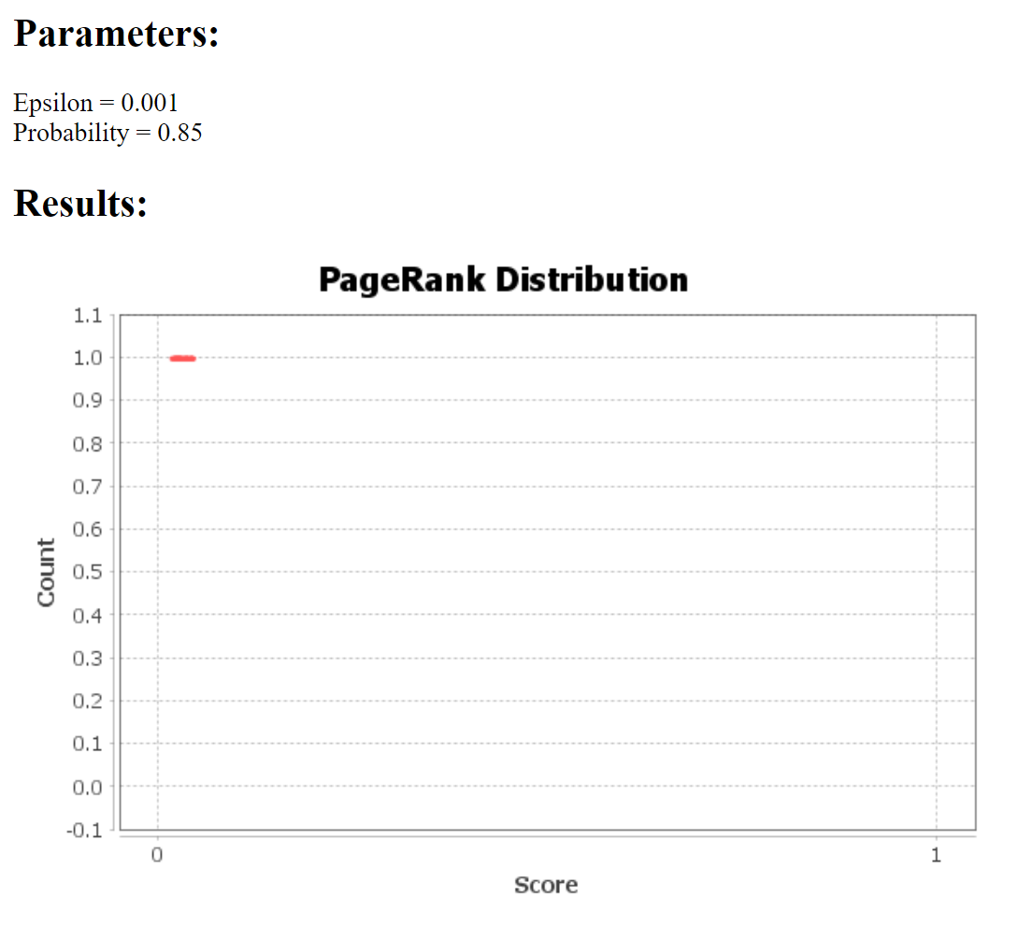
ATTACHMENT
Image 1.8
Nike PageRank

Slide 20
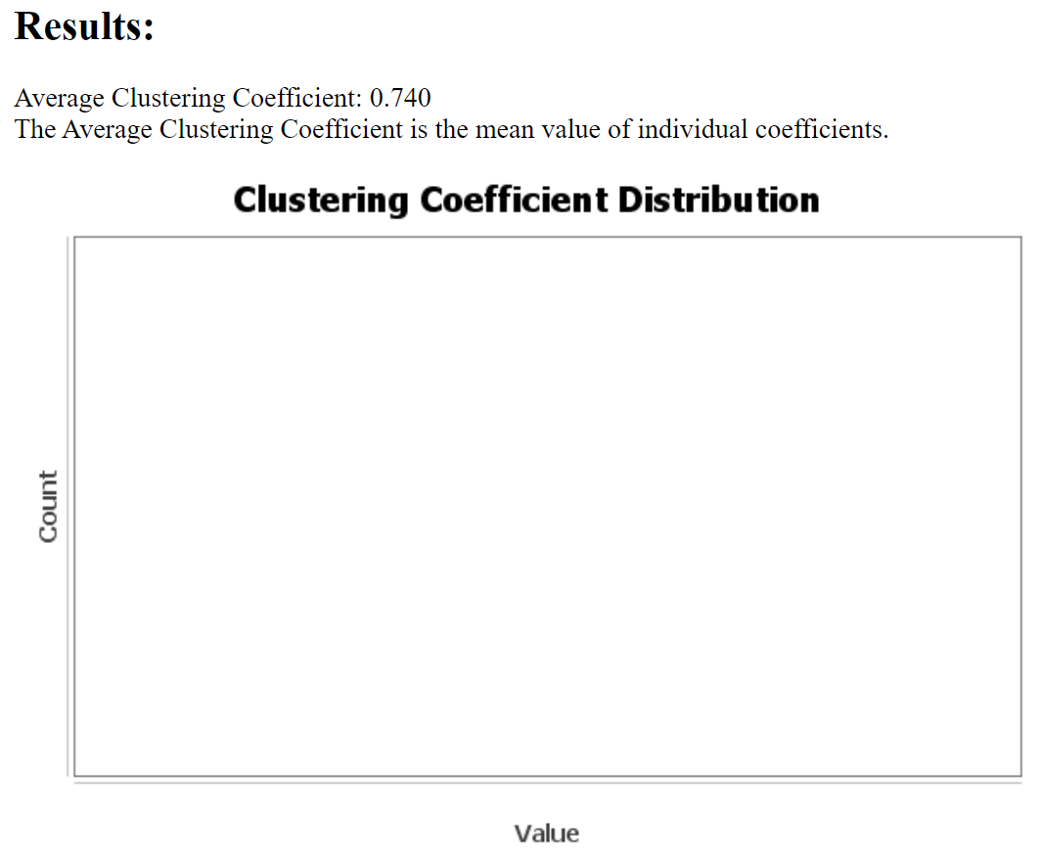
ATTACHMENT
Image 1.9
Nike Clustering Coefficient

Slide 21
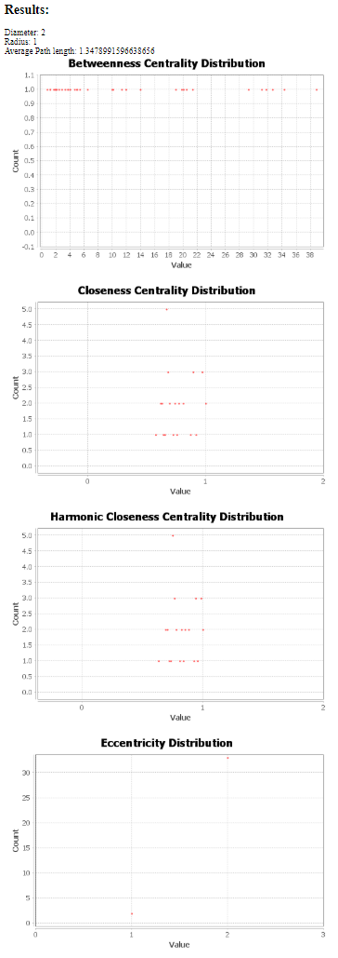
ATTACHMENT
Image 2.0
Skechers Network Diameter

Slide 22
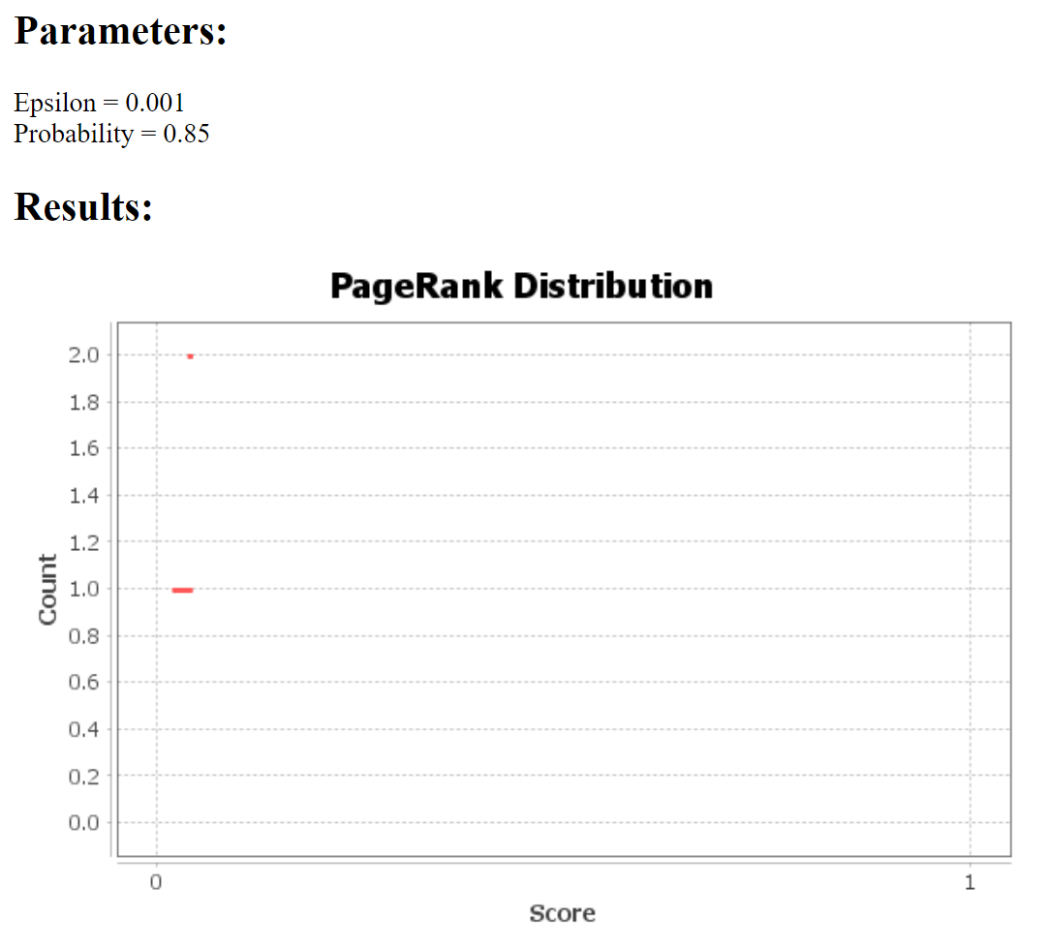
ATTACHMENT
Image 2.1
Skechers PageRank

Slide 23
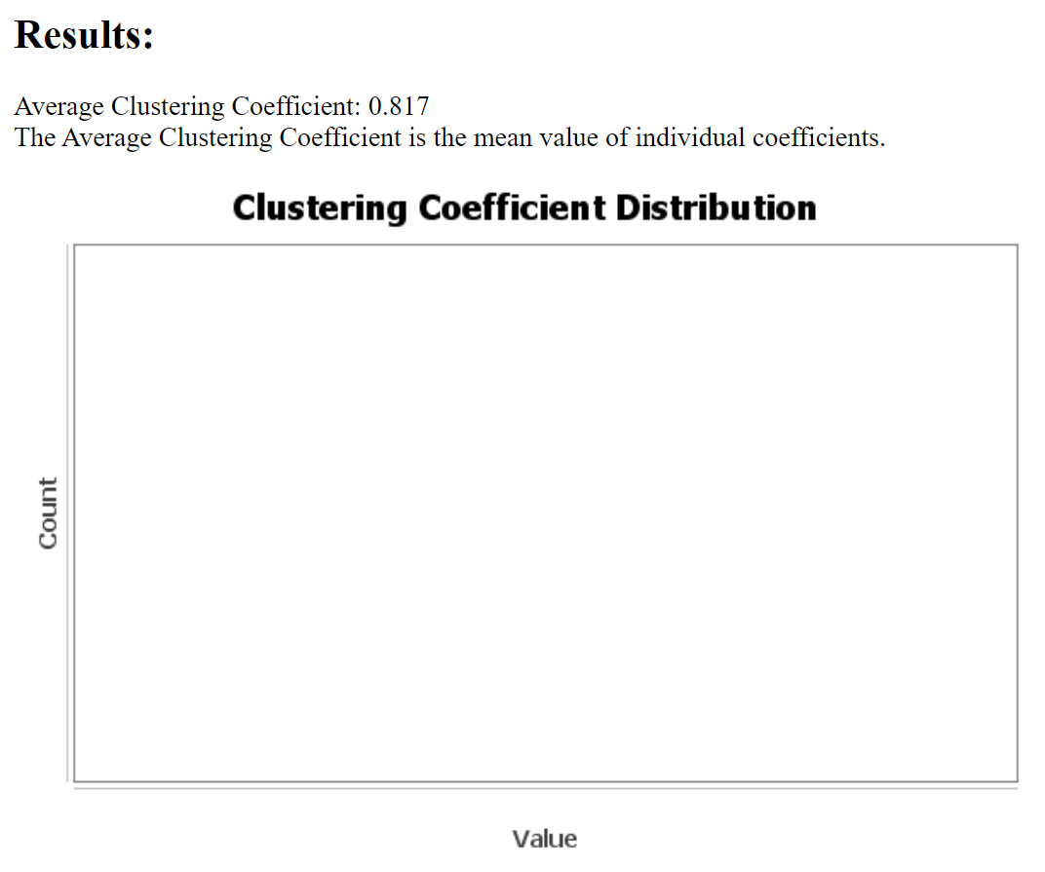
ATTACHMENT
Image 2.2
Skechers Clustering Coefficient

Slide 24
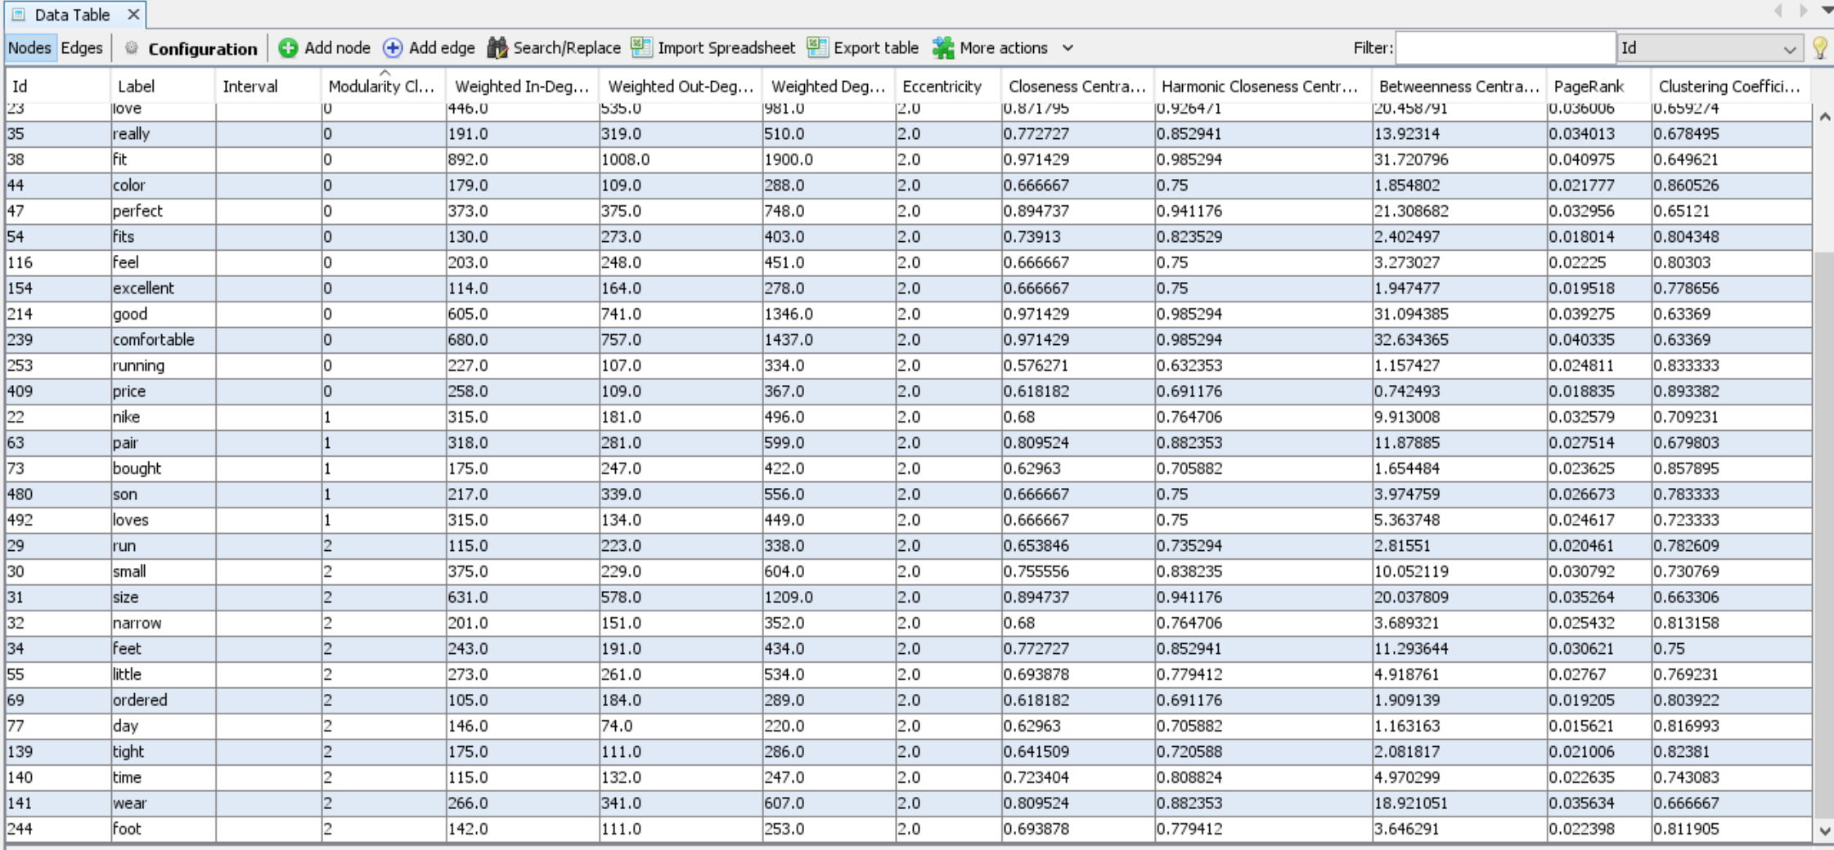
ATTACHMENT
Image 2.3

Slide 25
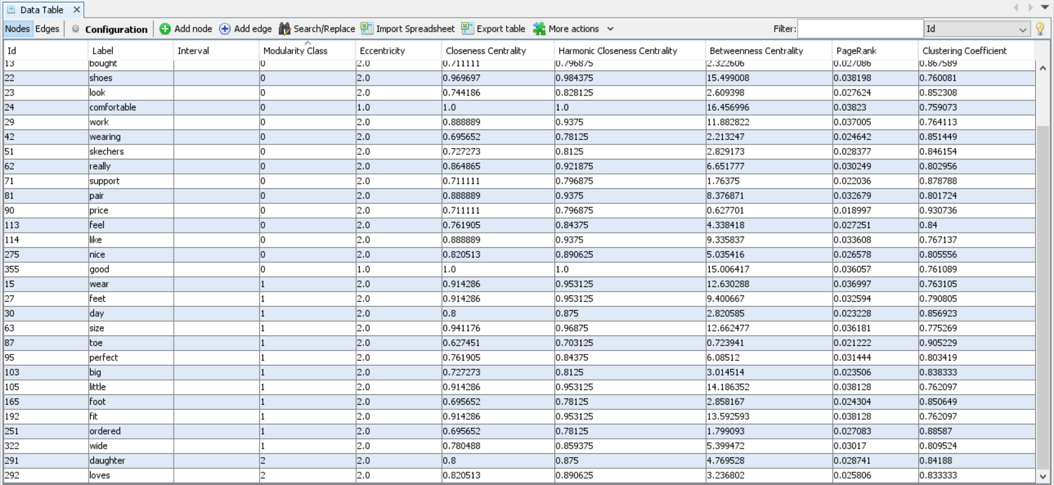
ATTACHMENT
Image 2.4

Slide 26
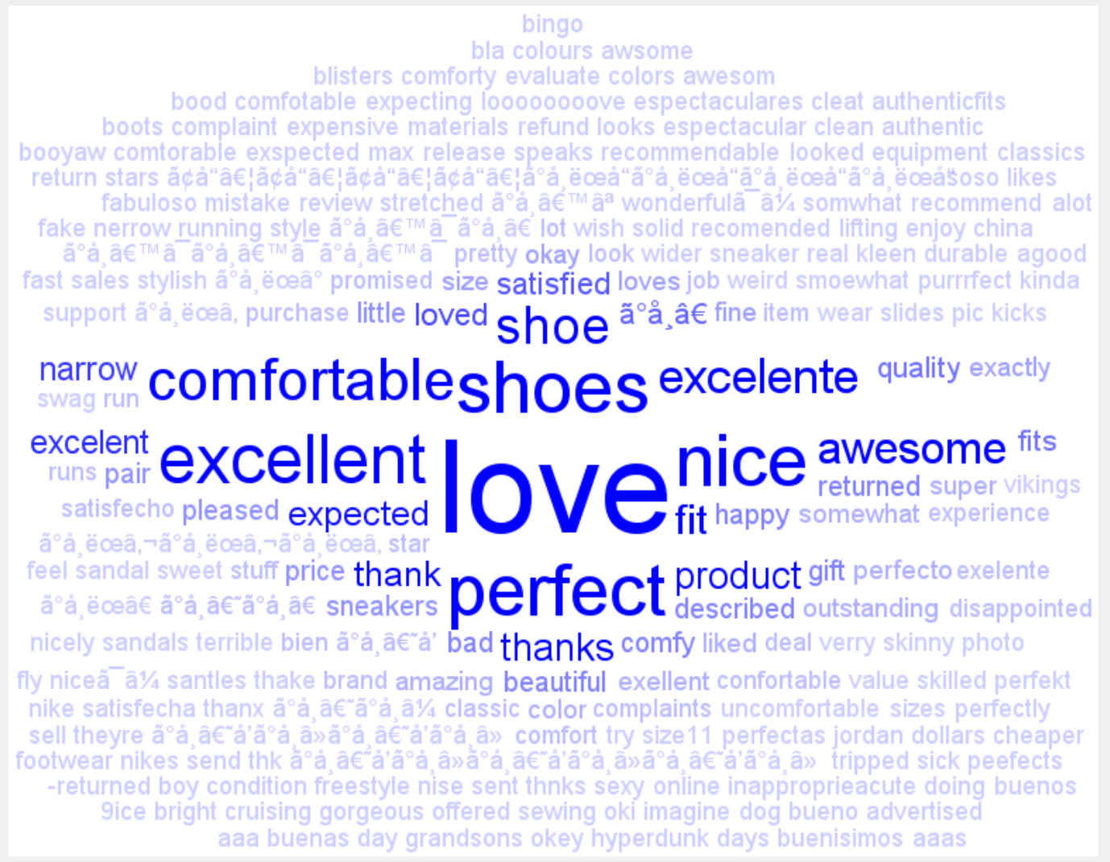
ATTACHMENT
Image 2.5

Slide 27
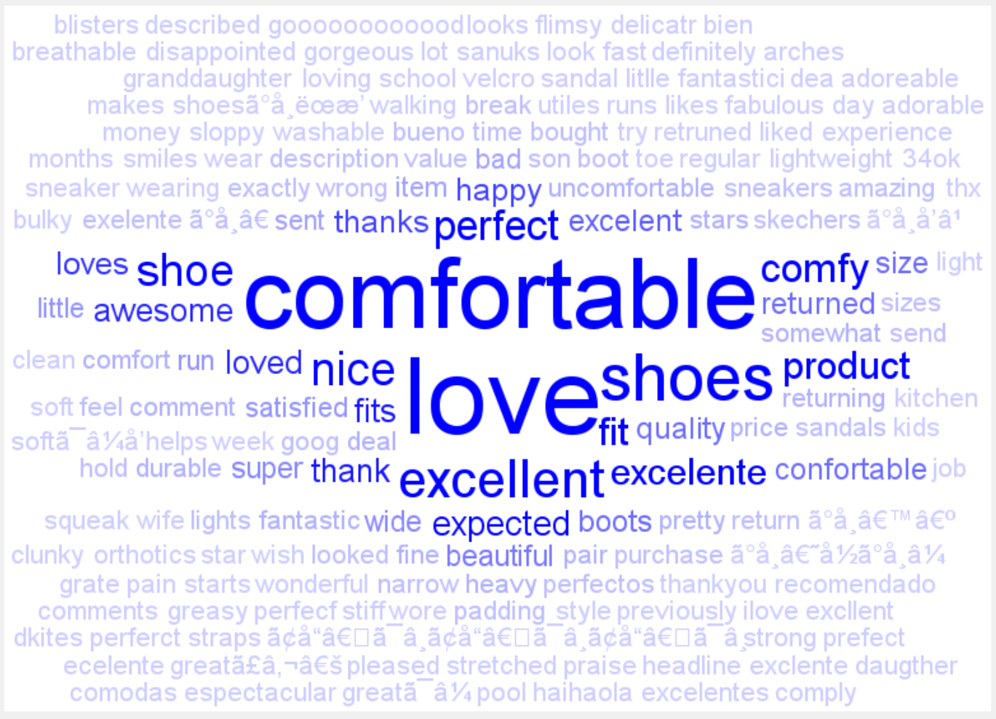
ATTACHMENT
Image 2.6

